Slide 1
Chapter 3.11
More on Equations
Algebra Concepts

Slide 2
Objective
Students will represent written descriptions with
algebraic expressions and equations.

Slide 3
Words to Know
Integer: a number (x)
Consecutive: what comes next in order
Next Larger Integer: x + 1
Odd Integers: x, (x + 2), (x + 4)…
Even Integers: 2x, (2x + 2), (2x + 4),…

Slide 4
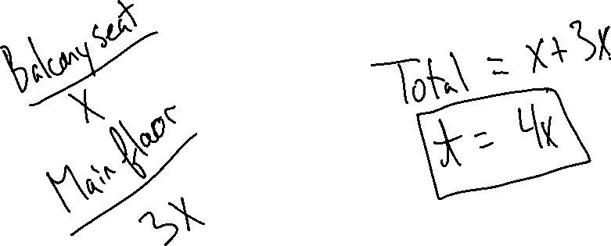
Example 1
The cost of a main floor seat is three times as much as the cost of a balcony seat. Write an expression showing the total cost of each seat.

Slide 5
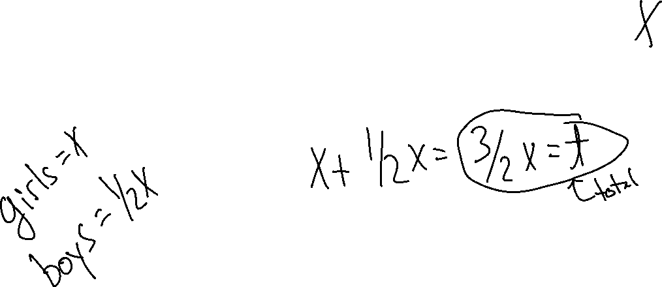
Example 2
There are half as many boys in a certain club as there are girls. Write an expression for the total number of boys and girls in the club.

Slide 6
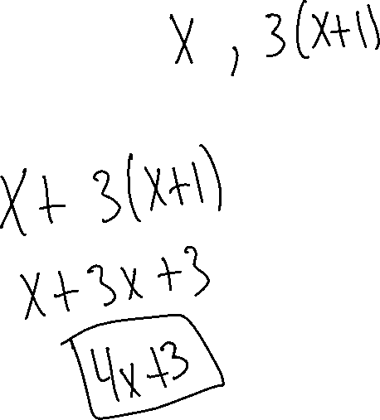
Example 3
Write an expression for the sum of an integer and three times the next larger integer.

Slide 7
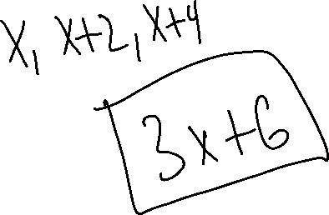
Example 4
Write the expression of the sum of three consecutive odd integers.

Slide 8
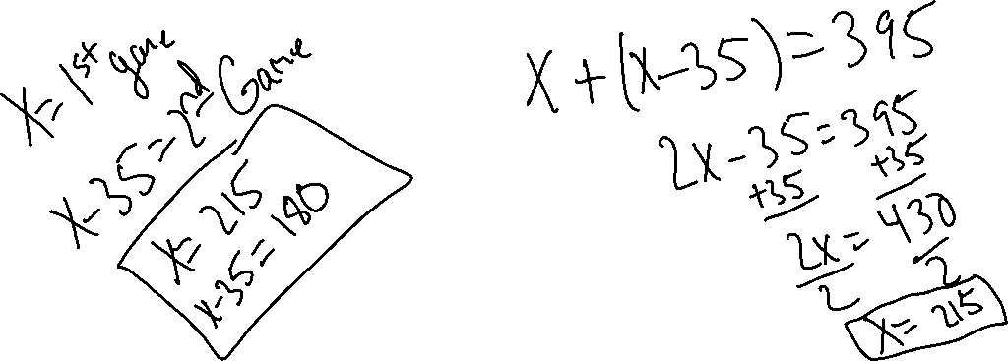
Example 5
Iandra scored 35 points fewer in her second bowling game than in her first game. Her total score for two games was 395. How many points did she score in each game?

Slide 9
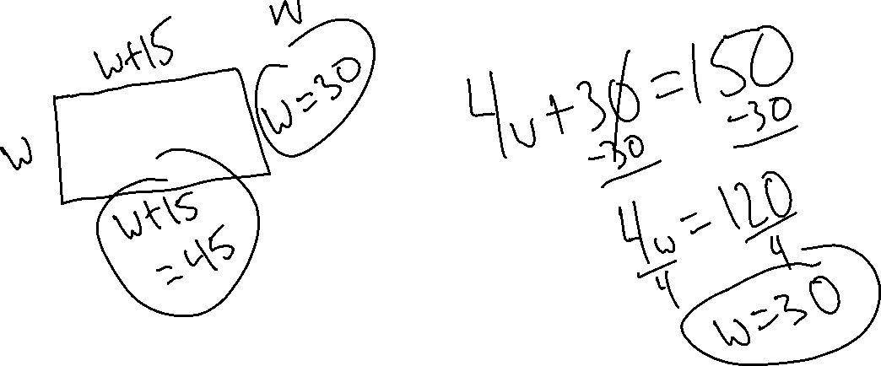
Example 6
The perimeter of a rectangle is 150 cm. The length is 15 cm greater than the width. Find the dimensions.

Slide 10
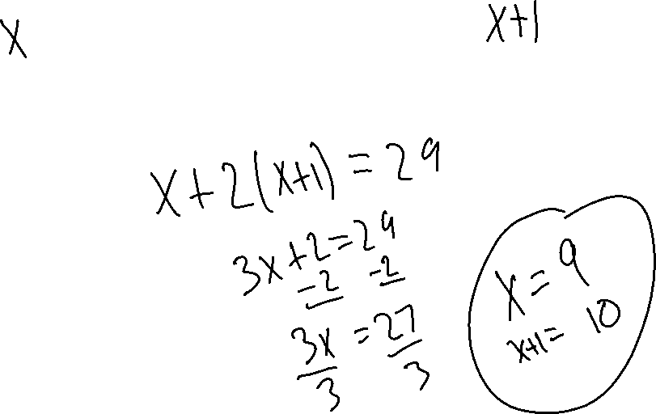
Example 7
The sum of an integer and twice the next consecutive integer is 29. What are the integers?

Slide 11
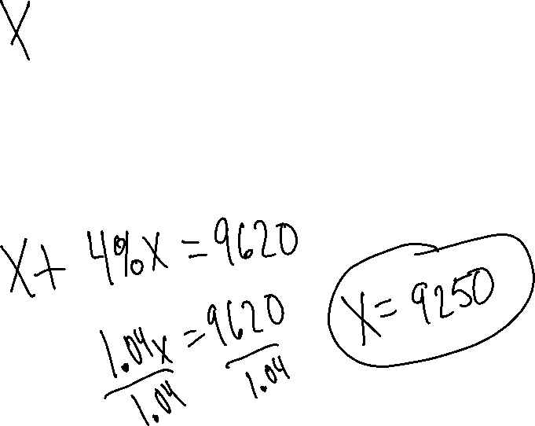
Example 8
Bryan deposited a sum of money in a savings account that pays 4% interest per year. At the end of one year Bryan had a total of $9620 in his account. How much did his originally deposit?

